Slide 1
Alexandros Antonopoulos

Slide 2
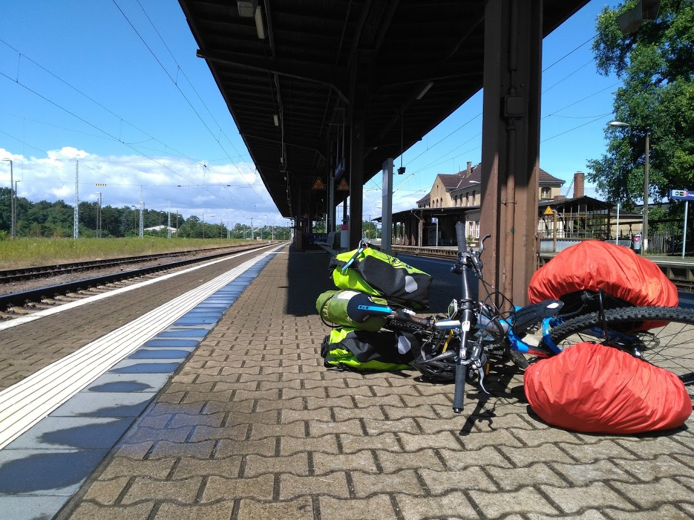
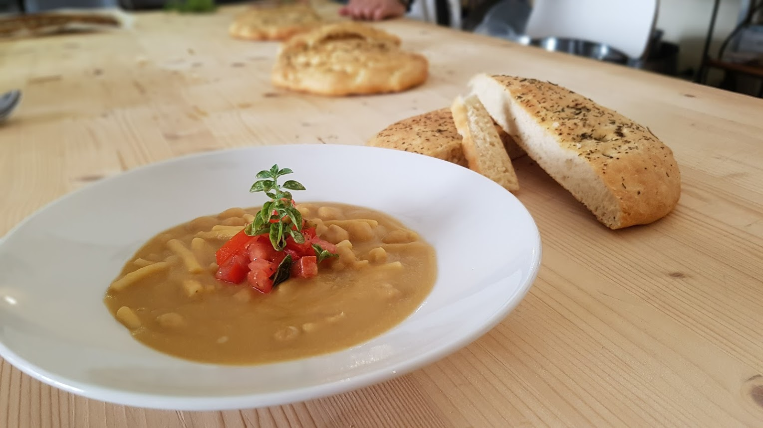
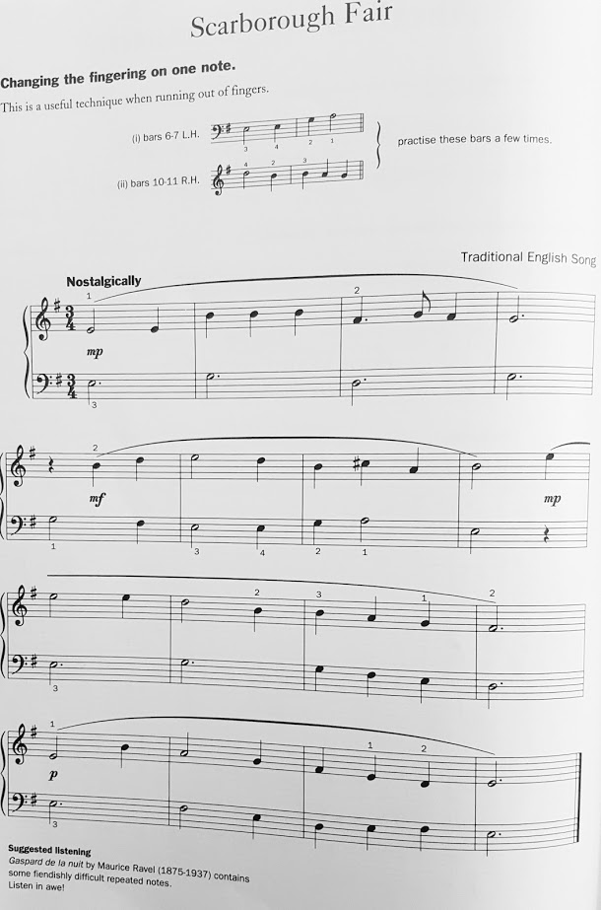
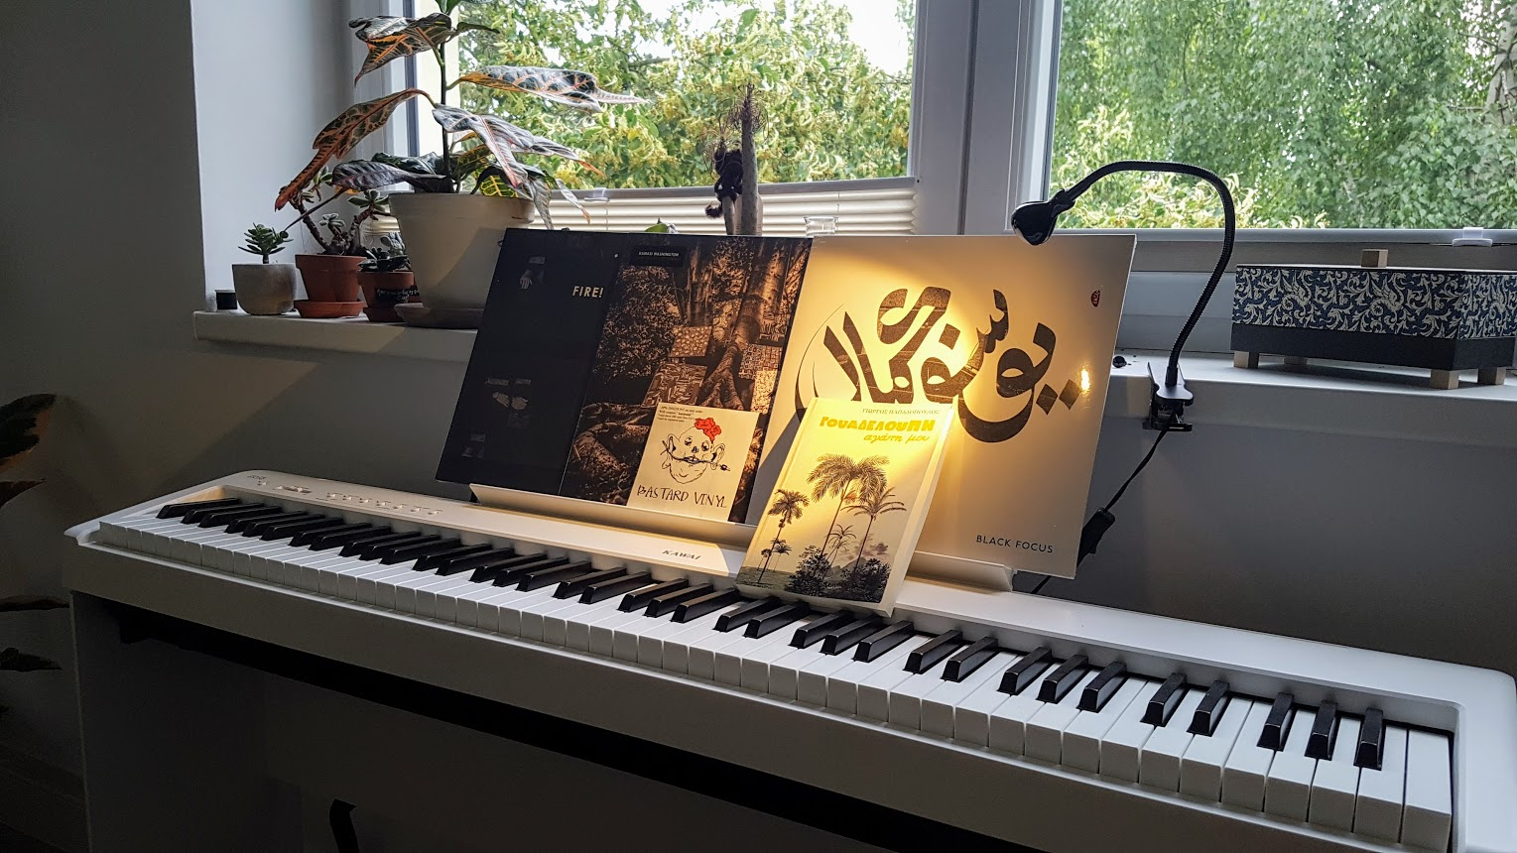
What do I do?
Cooking
Trying to play the piano
Biking
Hiking
Obsessively collecting plants

Slide 3

How can I help you?
Second semester at ReDI
Second course at ReDI
Intro to Python, spring 2018
Intro to Programming with Python, winter 2018
Software Engineer at HERE Technologies
SW Architecture
Navigation for automotive
Experience in python, C++, and a few others

Slide 4
How can you contact me?
Slack: alexandros.antonopoulos the easiest way
Email: antonopa@gmail.com

